Slide 1
Technical Integration Subcommittee
Tom Smith, Chair
Fourth Tuesday of the month

Slide 2
Roster

Slide 3
Agenda
June 23
Quick report out on each of the seven initiatives
Focus on Emerging Technologies for the majority of the meeting

Slide 4
2-3. TC Charter Refresh and Health Metrics
TC Charter Refresh
Action TIS members: Keep after the TCs to get the Charters in
TC Health metrics
Vlad is on it and the work is ongoing.
Health metrics come from the TC annual report which is a questionnaire
He received a list from Angie in Excel that was helpful
Mike previously mentioned AIAA will migrate from NetForum to Altai Systems 4th qtr this year
We can talk about improvements and automation then

Slide 5
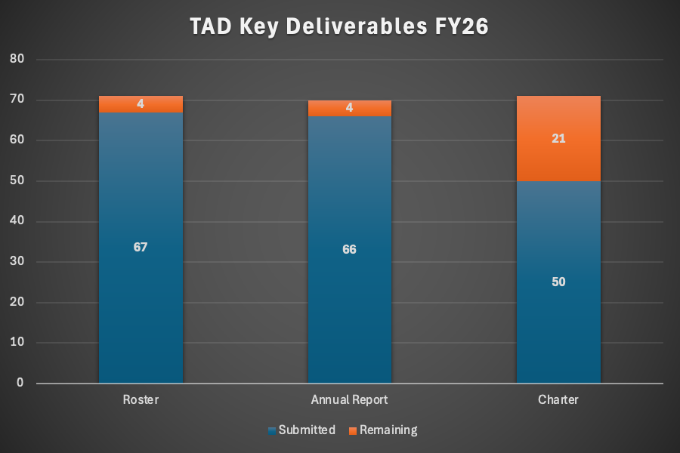
Key Deliverables Submissions*
Ongoing
*Fluid Instability and Transition was not required to submit an annual report; Space Transportation is classified inactive and has not been included as part of this data call.
Notes:
TAD Deliverables are tracking well. Very good showing from TCs.
Rosters are 94% complete
Annual Reports are 94% complete, with one TC (Fluid Instability and Transition) not required to submit because they were chartered in November last year.
Charters are 70% complete. Group Directors are reviewing charters and approving/workshopping them with the committees.

Slide 6
5. Emerging Tech June 23
Ron Kohl’s plan for the Space Domain has acquired a list of emerging technologies from NASA. It has 180 emerging technologies. Very complete.
Use the list, send it to the TC chairs, and ask them
Do you consider these important criteria
Is this something your TC has interest in
Is there anything you can think of to add to the list?
Action: Ron to send us his list so we can all try to mimic it
We could all try to get lists from NASA, DOW, DARPA, etc.
Action, All TIS members do their own hunting
Plan of action for now (will evolve later)
Each TIS member gets list
Each TIS member runs list by TCs and gathers responses
Elevate gaps
Contact John Valasek to see what he thinks would be a good use of AI here.
Action Jim to contact John Valasek (Valasek@tamu.edu) to get him to come to our meeting
Also consider running this past other parts of the institute, for example the Ascend Guiding Coalition
Mike could help ID them for us.

Slide 7
6. Create TIS server space and collect TIS documents
Mike started an AIAA Google Drive
We can use our Home Laptops to do this
https://drive.google.com/drive/folders/1qVzgT3BEHDCNVJVptEkWIKRvNFBesXLk?usp=drive_link
We are suggesting that we use GitHub
Ron says that the AIAA CIO spoke of our challenges and how we might solve them, like Engage, etc. He might solve this.
Tom created a TIS site on GitHub and sent it to the group to join
Action TIS members to try to join the GitHub site.

Slide 8
7. Get familiar with what AIED doing and how it relates to TIS
June 23 Vlad Reported. Contacted Jeanette Domber. Waiting for reply
The AIED redesign is happening. An update at the next AIED meeting at Aviation.
Vladimir volunteered
Ron may help him. Ron is in two OCs and an IC. There is an effort to redesign the AIED.
AIED is Aerospace Integrated Engagement Division
AIED meeting April 2. IOD will be presented with the redesign results
Ongoing

Slide 9
Archive or Backup

Slide 10
1. Establish the “General TC Guideline”
April 28 - No change from March
Tom Volunteered
Tom reviewed and marked up and Mike and Lesley are editing. Ball’s in their court.
Establish the “General TC Guideline”.
Starting point: There is an existing TC Chair’s Manual. Michael Lagana (AIAA) noted that it needs an update, which is in TIS’s scope. TIS should review and propose updates/edits, which could include incorporating information from other documents (e.g., the Structures TC document) as well as the additional sections (below).
Structures TC has their own “General TC Guideline”
TC Chair Exit Interview Process could be a part of that guideline with suggested questions to be answered by outgoing TC Chair
MDO TC has a process where they elect TC Vice Chair who automatically becomes TC Chair after 2 years and works with TC Chair while being Vice Chair. Therefore, TC votes for the Vice Chair, which effectively becomes a 4-year commitment.
Done

Slide 11
4. Work with TCs to communicate to them the important aspects leadership flowdown
April 28 - No report for April
Mike Volunteered. Matches his current activities anyway
Ongoing: Work with TCs to communicate to them the important aspects of: - Mike
TAD Director’s Roundtable
TAD Leadership Positions
TAD Exec mtg agenda/summary, CoD mtg summary.
Compile Documentation on TAD Leadership Positions. Follow-up Actions from AIAA CTO Summit on AI Applications
Collect TC’s response and proposals and communicate that to TAD and Directors. Work closely with Michael Lagana and his monthly committee newsletter.
Done
TC News letter does it

Slide 12
5. Capture Emerging Technologies and Trends
Three domains: Space, Aviation and R&D and Defense
Ron agreed to Space
Phil Ansell agreed to Aviation
Brian Freno agreed to R&D and Defense
Ron told of the survey sent to TCs about emerging technologies. Got some responses.
How does searching for ETT look like
AAA was going to do a LLM deep dive into the literature to find ETT. Lots of good topics. Still not as much as we would like.
Last fall AIAA Tech Survey.
How about we require TCs to keep their own Emerging Technologies list and submit it to TIS every year to coordinate? Maybe keep this at the group level. This list should percolate into the TCs Call for Papers. Add this to the TC charter and CFP.
Ultimate goal is to comb the technologies and see if they fit in existing TCs or warrant a new TC, working group, IC, Panel Session

Slide 13
Emerging Tech April 28
Ron
Converge on what is the problem we are trying to solve
Could start by building the ETT list
Bounce list off of the TCs buckets and see which technologies are not addressed by any TCs. These are gaps.
Groundrule – Use this list to maintain the value of AIAA vs. other societies like SAE
Will share with TCs, ICs, etc.
Could share list with Domain leads. Domains are in charge of future thinking for the institute. Ryan Patrick, R&D is aware of our ETT activity but has not reached out to us yet.
Could share with the Corporate Advisory Board as well.
Phil
Here is what Phil assumed to be the purposes of the emerging tech tracking process:
This tracking process serves two pivotal purposes:
Avoids confusion and cross-talk across TCs and IOCs when new topics emerge (where does a topic "fit" and how can we co-sponsor across groups?).
Ensures we are keeping a pulse on new, high-impact developments and not missing opportunities to expand what AIAA has to offer to the aerospace community.

Slide 14
New Business April 28
Emerging Trends
In Space Disaster Management.
In Space Health Care
Ron thinks these might end up in IOD.
Ron has introduced to his Space Settlement TC. The TC vice chair is a space nurse who has created a subcommittee around Space Health Care.
Ron has taken on Space Disaster Management. Stuck so far. Could be a subcommittee. Could evolve into a TC or IC. Building it as a Community of Interest (used to be a thing).
Ron says that the focus on Technology oriented TCs versus capability-oriented groups is somewhat of a gap for AIAA. Maybe make ICs more capability-oriented.
Brian has started a computational physics community. There was a meeting in Feb with great turnout. Will have a SciTech 2027 session. Will have a meeting at Aviation. Goal is to evolve it into a TC. Getting traction in TAD, with CFD standards group and others.

